Slide 1

Lecture 4-7 Classes and Objects

Slide 2
Contents
Introduction to Classes and Objects
Class declaration
Creating Objects
Accessing Object Members
Defining Member Functions
Nesting of Member Function
Access Specifiers: Public , Private
Scope Resolution Operator
Nested Classes

Slide 3
Classes
Different from structures
Adds member functions
Not just member data
Integral to object-oriented programming
Focus on objects
Object: Contains data and operations
In C++, variables of class type are objects

Slide 4
Specifying a Class
A class is a way to bind the data and its associated functions together.
A class specification has 2 parts:
Class declaration
Class function definitions
Class declaration: describes type and scope of its members.
Class function definitions: describes how the class functions are implemented.

Slide 5
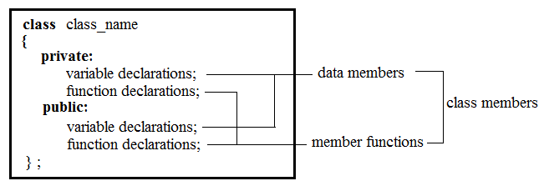
General form of Class declaration

Slide 6
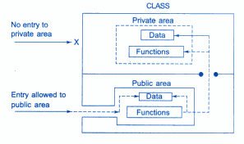
Data Hiding

Slide 7
Difference between Structure and Class
By default, members of class are private, while, by default, members of structure are public.
Encapsulation
The keywords public and private are known as visibility labels.

Slide 8
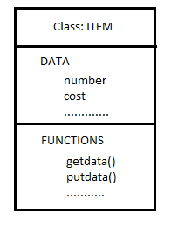
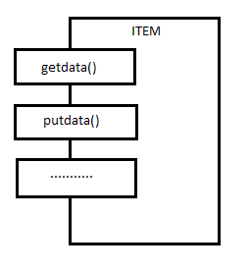
A Simple Class Example
class item
{
int number;
float cost;
public :
void getdata(int a, float b);
void putdata (void);
};
Class Representation
Creating Objects:
item x;
Accessing Class Members:
Object_name.function-name (actual-arguments);
x.getdata(100, 75.5); x.putdata( );

Slide 9
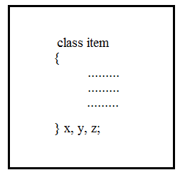
Creating Objects
Objects can also be created as follows:

Slide 10

Example Books Library
borrower
Title
Author
Cost
DOI
Name
Roll No
Address
Books
DATA
issue()
Fine()
return()
Open()
Close()
request()
renew()
search()
Enroll()
methods

Slide 11
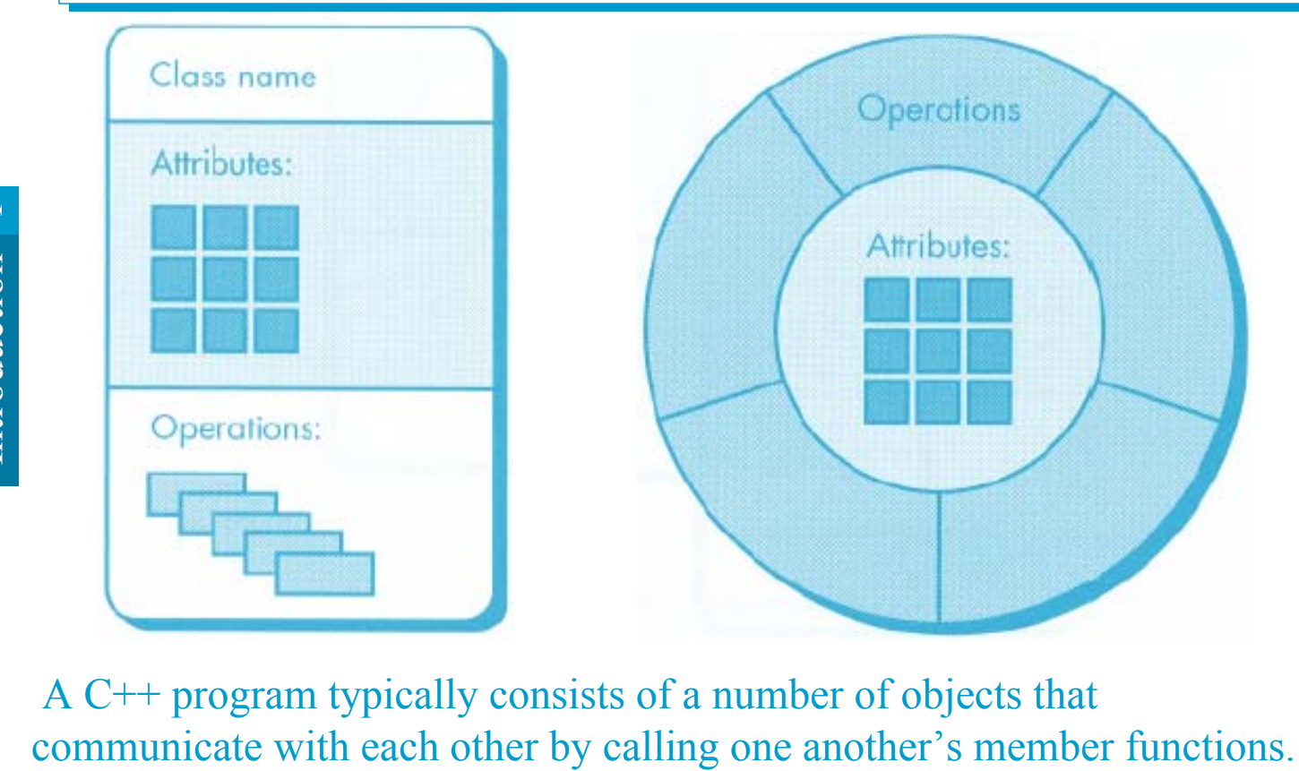
Object Model

Slide 12
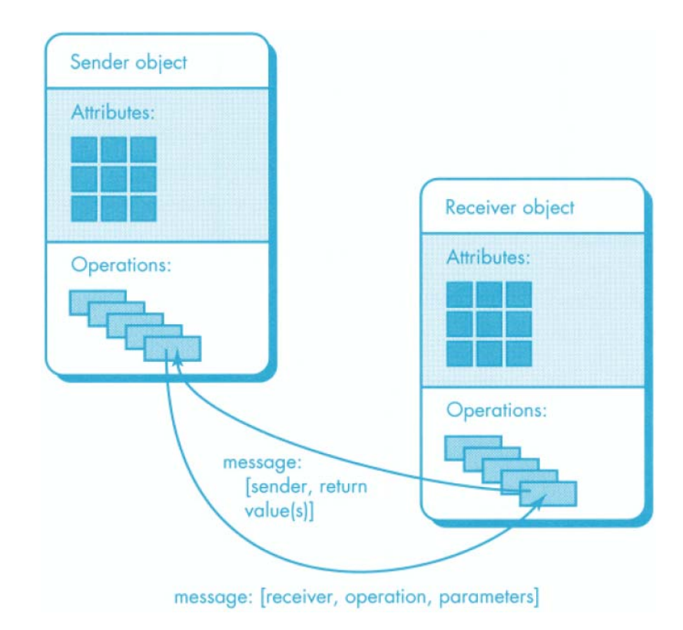

Slide 13
Need more knowledge for 3 & 4
Functions can be defined inside structure in C++
Using struct keyword not required in C++
C++ structures can have static members
C++ allows data hiding by using access modifiers

Slide 14


Classes in C++ are similar to struct for syntax
struct – everything is public by default
class – everything is private by default.

Slide 15
What is the output of the following program?

Slide 16
#include <iostream>
using namespace std;
class Person{
int age;
int setAge(int a){age = a;}
int display() {cout <<"Age: " << age << endl;}
};
int main(){
Person p1;
p1.setAge(20); p1.display();
return 0;
}

Slide 17
Answer - Output – Compilation Error
[Error] 'int Person::setAge(int)' is private

Slide 18
Now we use public: specifier for data and functions in class

Slide 19
#include <iostream>
using namespace std;
class Person{
public: // Everything after public: becomes public
int age;
int setAge(int a){age = a;}
int display() {cout <<"Age: " << age << endl;}
};
int main(){
Person p1; p1.setAge(20);
p1.display(); return 0;
} // everything public in class means it becomes a struct

Slide 20
Output = Age: 20

Slide 21
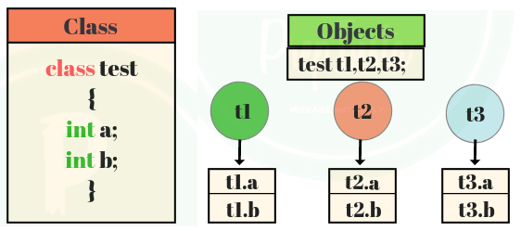
Each object has its own variables/functions

Slide 22
Access specifiers in C++
Public
Private
Protected (for later until we cover inheritance)

Slide 23
Data private and functions public. What will be the output of following program?

Slide 24
#include <iostream>
using namespace std;
class Person{
int age;
public: // Everything before public: is private
void setAge(int a){age = a;}
int display() {cout <<"Age: " << age << endl;}
};
int main(){
Person p1; p1.setAge(20);
p1.display(); return 0;
}

Slide 25
#include <iostream>
using namespace std;
class Person{
int age;
public:
void setAge(int a){age = a;} //setter function
int getAge() {return age;} //getter function
};
int main(){
Person p1; p1.setAge(20);
cout <<"Age: " << p1.getAge() << endl;
}

Slide 26
Memory Allocation for Objects
Memory space for objects is allocated when they are declared and not when the class is specified : partially true.
Since all the objects belonging to that class use the same member functions, no separate space is allocated for member functions when the objects are created.
Only space for member variables is allocated separately for each object. Because, member variables will hold different data values for different objects.

Slide 27
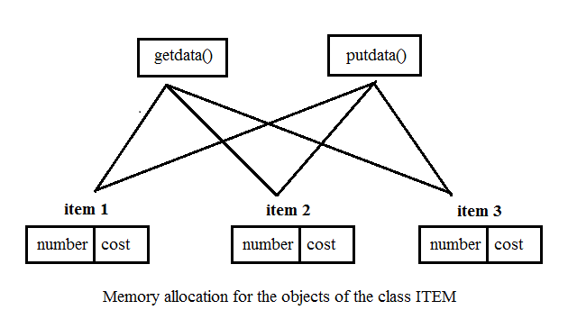
Example

Slide 28
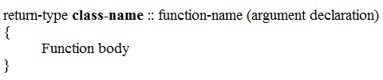
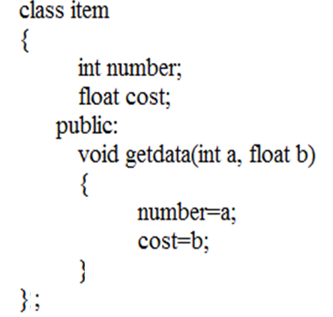
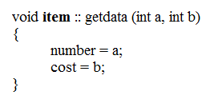
Defining Member Functions
Outside the class definition
When function is defined outside class, it requires a prototype declaration in the class.
Inside the class definition
When function is defined inside class, it does not require a prototype declaration in the class.

Slide 29
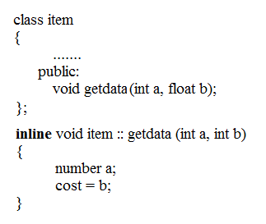
Inline Functions
We can define a member function outside the class definition and still make it inline by using the qualifier inline in the header line of the function definition.

Slide 30
Nesting of Member Functions
An object of a class using dot operator generally calls a member function of the class.
However, a member function may also be called by using its name inside another member function of the same class.
This is known as “Nesting of Member Functions”

Slide 31
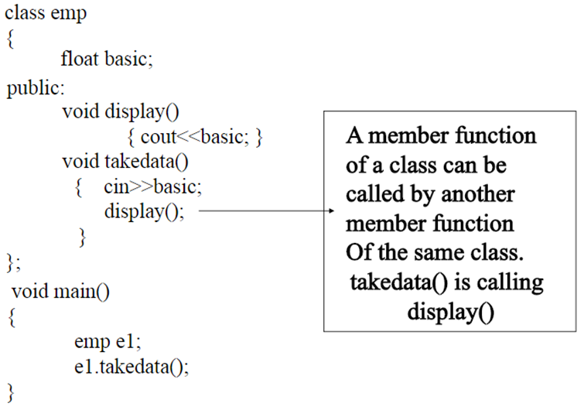
Nesting of Member Functions

Slide 32
Data Hiding Revisited

Slide 33
Access Specifiers in C++
3 types of access modifiers available in C++:
Public
Private (by default)
Protected

Slide 34
Access Specifier: Public
Public members are accessible outside the class.
Public members are accessible to both member Functions and non-member Functions.
Objects can access the members directly using dot operator. E.g.
object name.public data member
object name.public member function

Slide 35
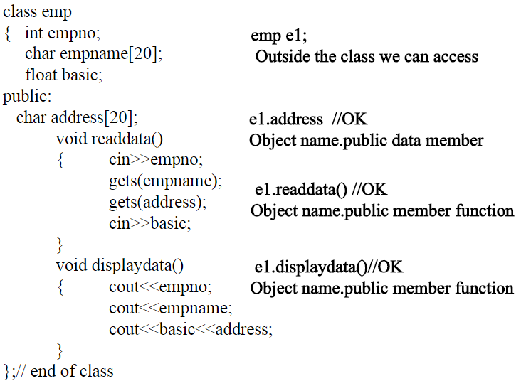
Access Specifier: Public

Slide 36
Access Specifier: Private
Private Members can only be accessed by the member functions of that class.
They cannot be accessed by any non member functions (data is hidden from outside world).
Object of a class cannot access private members using dot operators.
All data at the beginning of a class is by default private, until any specifier is mentioned.

Slide 37
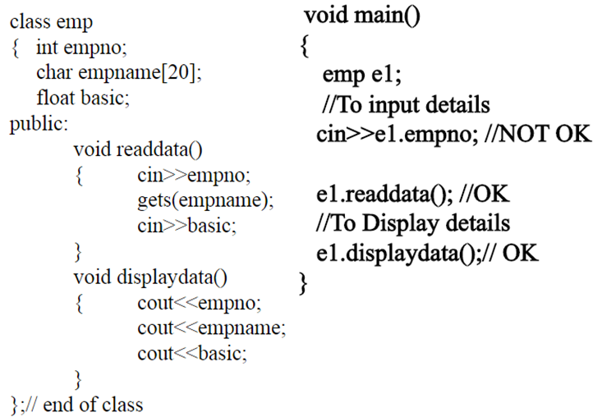
Access Specifier: Private

Slide 38
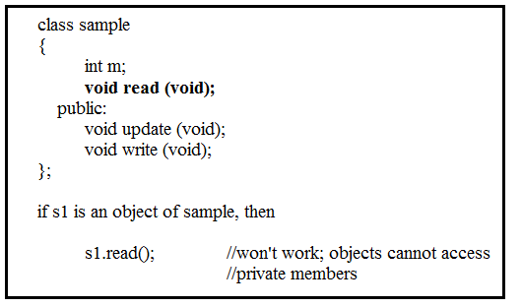
Private Member Functions

Slide 39
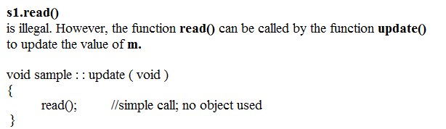
Private Member Functions

Slide 40
Scope Resolution Operator
1. Member functions defined outside class
Using Binary scope resolution operator (::)
“Ties” member name to class name
Uniquely identify functions of particular class
Different classes can have member functions with same name
Format for defining member functions
ReturnType ClassName::MemberFunctionName( ){
…
}

Slide 41
Access Specifiers in C++
class Circle{
private:
double radius;
public:
Circle() { radius = 0.0;}
Circle(int r);
void setRadius(double r){radius = r;}
double getDiameter(){ return radius *2;}
double getArea();
double getCircumference();
};
Circle::Circle(int r){
radius = r;
}
double Circle::getArea(){
return radius * radius * (22.0/7);
}
double Circle:: getCircumference(){
return 2 * radius * (22.0/7);
}

Slide 42
Scope Resolution Operator
2. To access a global variable when there is a local variable with same name
#include<iostream>
using namespace std;
int x; // Global x
int main() {
int x = 10; // Local x
cout << "Value of global x is " << ::x;
cout << "\nValue of local x is " << x;
return 0;
}

Slide 43
Scope Resolution Operator
3. To access a class’s static variables
class Test {
static int x;
public:
static int y;
void func(int x) { // We can access class's static variable even if there is a local variable
cout << "Value of static x is " << Test::x;
cout << "\nValue of local x is " << x;
}
};
int Test::x = 1; // In C++, static members must be explicitly defined like this
int Test::y = 2;
int main() {
Test obj;
int x = 3 ;
obj.func(x);
cout << "\nTest::y = " << Test::y;
return 0;
}

Slide 44
Scope Resolution Operator
4. In case of multiple Inheritance
If same variable name exists in two ancestor classes, we can use scope resolution operator to distinguish.
Detail would be discussed in inheritance………………

Slide 45
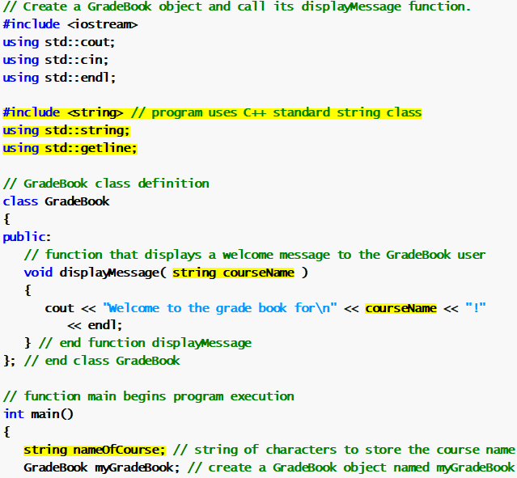
Scope Resolution Operator
5. Including In-built libraries.

Slide 46
Scope Resolution Operator
5. Including In-built libraries.

Slide 47
Nested Classes
A class is declared within another class.
The outer class is called enclosing class and inner class is called the nested class.
A nested class is a member and as such has the same access rights as any other member.
The members of an enclosing class have no special access to members of a nested class; the usual access rules shall be obeyed.

Slide 48
Nested Classes Example
#include<iostream>
using namespace std;
class Enclosing /* start of Enclosing class declaration */
{
int x;
class Nested
{ /* start of Nested class declaration */
int y;
void NestedFun(Enclosing e)
{
cout<<e.x; // works fine: nested class can access
// private members of Enclosing class
}
}; // declaration Nested class ends here
}; // declaration Enclosing class ends here
int main(){}

Slide 49
Nested Classes Example
#include<iostream>
using namespace std;
class Enclosing /* start of Enclosing class declaration */
{
int x;
class Nested
{ /* start of Nested class declaration */
int y;
}; // declaration Nested class ends here
void EnclosingFun(Nested n)
{
cout<<n.y; // Compiler Error: y is private in Nested }
}; // declaration Enclosing class ends here
int main(){}

Slide 50
Thank You

